Slide 1
Wells Fargo US-Balanced scored cared
Name
Institution
Date

Slide 2
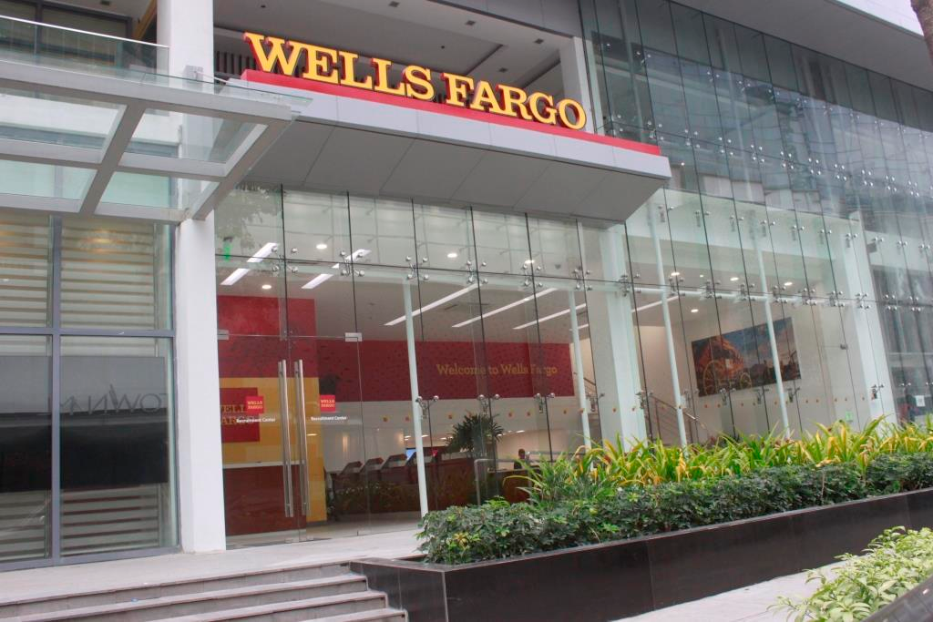
Wells Fargo US
Wells Fargo is an American multinational firm dealing with financial services.
Wells Fargo US is the fourth largest Bank in terms of market capitalization.
It is the fourth largest bank in the United States in terms of its assets.
The Bank’s head office are in San Francisco, California with current branches at 5997 across the United States. Its main competitor JPMorgan Chase has 5288 and Place Bank of America with 4584 branches.
Just like the top three bank’s, it does not have presence in the entire 50 states of America.
Although it is not a multinational company, it is able to operate internationally through duly authorized and regulated subsidies
Notes:
Wells Fargo is a an American multinational company
The fourth largest bank in the world-Market capitalization
Forth bank in US-Assets net
Head office –San Francisco
Branches- 5997
Main competitor branches JPMorgan- 5288 branches, Place Bank – 4584
Operates internationally through authorized and regulated subsidiary institutions

Slide 3
Why Balanced scorecard System?
Customer dissatisfaction as well as challenges in implementation are the greatest drivers for the new innovative ideas. Previously companies have struggled with the problem despite their clear visions and strategic plans. Therefore, they are in capable of transitioning of the ideas into operative goals as well as actions without incurring losses.
The modern business world, that is highly competitive as well as fast changing world, there is need to develop a fast and effective translation of the business strategy into action to achieve the desired and planned goals and objectives.
The other challenge that firms farce is the fact the controlling systems only target the accounting data for the companies while failing to meet the modern expectations any further.
A balanced score card is defined as performance metric that companies use to examine, better as well as control a business’s different functions and the resultant outcomes.
Notes:
The companies have goals and objectives well laid in the strategic plans but are incapable of transitioning into the real actions.
The balanced score card was introduced in 1992 by David Norton and Robert Kaplan.

Slide 4
Wells Fargo- Introduction of balance scorecard
The balanced score card in Wells Fargo measures four Key parameters
The customer perspective
Wells Fargo uses this performance metric to determine the nature in which customers see and value the organization. The bank must offer excellent customer service to create a positive impression to them.
2. Internal perspective
Well Fargo uses this parameter to evaluate the functions that require dire improvement within the organization. This can done through identification of areas that bring in more revenues to the organizations and are poorly managed hence may lower the income due to poor service delivery. For instance, the cashiers in the banking hall must serve customers diligently and honestly.
3. Innovation and learning perspective
This performance metric detail the need for the bank to develop more innovations to improve the service delivery to the customers. Modern banking does not require customers coming to the banking halls to withdraw funds rather the services are offered within their convenience and vicinity either through agency banking, internet banking, mobile banking and allow swapping to purchase goods and services.
4. Financial perspective
The performance parameter details how the organization creates value to the shareholders investment. Wells Fargo is owned by shareholders through purchase pf shares hence the shareholders often want to see the growth of their shares in terms of value. This is attained when the income levels are improved over the years (Bento, Mertins, and White, 2017).
Notes:
Balanced score parameters- The customer perspective, internal perspective, innovation and learning and financial perspective

Slide 5
Customer perspectives
Goals | Measures
New products | Determine the percentage if sales from new services introduced into the firm Evaluate the percentage of sales from the existing products and services
Responsive supply | Ensure that customers receive the services required within the time frame without delays. For instance, ensure minimal interruptions with the channels. Ensure that the channels are simple and effective for the clientele to use them
Customer partnership | Create some avenues where the customers are able to partner with the bank. This can be done effectively through supplies of different items.

Slide 6
Financial perspectives
Goal | Measures
Survive | Wells Fargo should ensure that the cash flows are available to facilitate the business growth and continuity.
Succeed | There is need for Wells Fargo to match the quarterly sales of the services and operating income growth from the different divisions within the organization.
prosper | Wells Fargo must strive to maintain the current market share while increasing the world wide trading activities to generate more income. This would increase the shareholders value which is the ultimate goal of financial institutions.

Slide 7
Internal business perspective
Goals/Objective | Measures
Technological capacity | Wells Fargo must determine whether the current ICT infrastructure is capable of reaching all the clientele without experiencing hurdles.
Production Excellence | Wells Fargo should strive to ensure that resources used to convey and offer services to the consumers are not waste depleted. For instances, ensure SMS are purchased on time to avoid instances where the customers do not get messages for their transactions.
New service/ product introduction | New products and services are introduced with the main objective of bettering the financial service delivery to the customers. The new services should put customers priorities first.

Slide 8
Innovation and learning perspective
Goals | Measures
Technology leadership | Wells Fargo should conduct aggressive market research to determine the customer wants hence improve the services delivery timely. It entails coming up with right innovations at the right time.
Product Focus | The company should strive to offer excellent banking solutions to the customers. Most business firms get it wrong when they mix different products from sectors hence creating confusion to the customers.
Time to market | The company should have clear guidelines on when to market the products and services. Furthermore, it should clearly communicate to the customers to avoid confusion issues and negative side chats.

Slide 9
Benefits of Balance score card
Some of the benefits of the balanced score card are outlined as follows
a). Better strategic planning and overcoming challenges
  A balanced scorecard assist wells Fargo in overcoming fundamental challenges hence improving goals such as; increase in the intangible assets, implementing strategy as well as performance measurement (Tayan, 2019).
b). Employee Engagement
  The Employee balanced scorecard often translate to the Wells Fargo’s scorecard by creating tangible objectives that are geared towards the roles and strengths of the employees. Therefore, they are used in creating synergies among the employees while encouraging cooperation and specialization of the respective employees.
c). Better Process Alignment
  Wells Fargo should utilize the balanced score card to align organizational processes including the budgeting, risk management as well as analytics with the strategic priorities. This would go a long way into developing strategies and plans that concentrate with the organization needs.

Slide 10
Disadvantages of balanced scorecard
a). Time and Financial Cost Investment
  To develop a balance scorecard require a huge chunk of investment in terms of time and financial resources. At times, the management may require services of consultants to discuss with the management on whether the plan is effective or not.
b). Stakeholder Acceptance and Usage
  The shareholders may accept or reject the balance scorecard. Therefore, for it to effectively work it must incorporate input from all the stakeholders including employees on their busy schedules to devote time to create a scorecard that would be accepted by all. In most cases, people rejecting it often have issues with accepting the changes in the organization. Therefore, it must require strong leadership to support it for it to be successful otherwise it would remain on paper.
c). Strategic Direction and Metric Planning
  There is need to ensure that the strategic objectives clearly have measurable metrics. Failure to plan as well as communicate with the relevant stakeholders would least likely to produce the desired end results. It is because it might become very bloated and hard to effectively manage when numerous elements are added to the scorecard. It is because it hard to convenience people to support your balance scorecard decisions (Hepler, et al., 2016).

Slide 11
References
Tayan, B. (2019). The Wells Fargo cross-selling scandal. Rock Center for Corporate Governance at Stanford University Closer Look Series: Topics, Issues and Controversies in Corporate Governance No. CGRP-62 Version, 2, 17-1.
Bento, R. F., Mertins, L., & White, L. F. (2017). Ideology and the balanced scorecard: An empirical exploration of the tension between shareholder value maximization and corporate social responsibility. Journal of Business Ethics, 142(4), 769-789.
Hepler, A. J., Anderson, B. E., Cooper, M. C., & Ogden, J. A. (2016). Keys to successful balanced scorecard implementation and use based on published implementation attempts. Journal of Transportation Management, 27(1), 3.

Slide 12
Thank you

